Slide 1
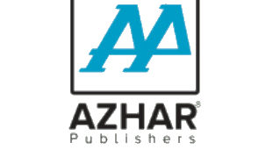


Islamiyat — الفتح اسلامیات (PCTB Ulma Board)
Grade 4
A curriculum textbook from the Alfatah Series.
A Project of Azhar Publishers

Slide 2
i
What's Inside
Islamiyat — الفتح اسلامیات (PCTB Ulma Board) • Grade 4
1
Quranic verses (آیات) with translation
2
Ahadith and their lessons
3
Stories of the Prophets (انبیاءؑ)
4
Islamic beliefs (عقائد) and worship (عبادات)
5
Good character and manners (اخلاق)
6
Exercises and revision after each chapter

Slide 3
★
Purpose & What You Get
Teaches core Islamic beliefs, worship and moral values for Grade 4, aligned to the Single National Curriculum.
“
Every book comes with
1
2
Interactive Digital Version
Page-Turn Flipbook
A book-level interactive activity set drawn from the book's content for engaging, screen-based practice.
A digital flipbook e-sample of the full book that opens from the right and turns like the real book.
A Project of Azhar Publishers • Alfatah Series

